Slide 1
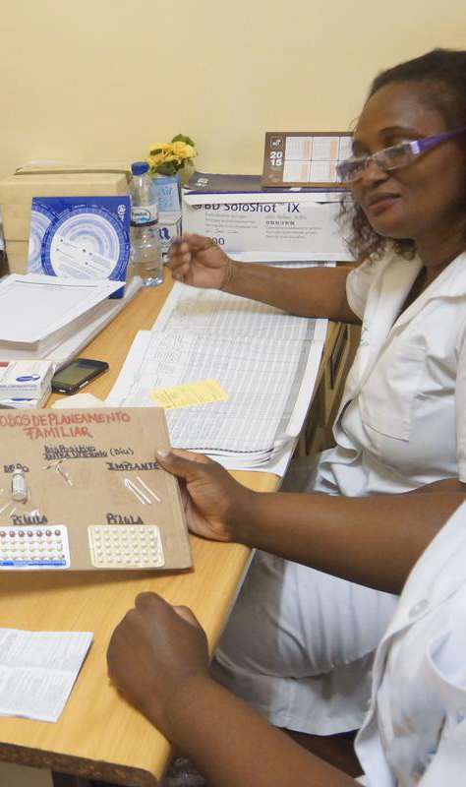
AIDS 2018
Amsterdam, The Netherlands
27 July 2018
07:00 – 08:30
Venue: Elicium 1
From research to policy to practice: WHO medical eligibility criteria (MEC) for progestogen only contraception use by women at high risk of HIV infection
Co-Chairs
James Kiarie, WHO RHR
Petrus Steyn, WHO RHR
Speakers
James Kiarie, WHO Human Reproduction Team,
Development of WHO MEC guidelines
Renee Heffron, Departments of Global Health and Epidemiology, International Clinical Research Center, University of Washington, USA
Differences in DMPA-IM, DMPA-SC and NET-EN relative to the potential impact on HIV acquisition in women
Petrus Steyn, WHO Human Reproduction Team
Implementation of WHO MEC recommendations
Lillian Mworeko, International Community of women living with HIV Eastern Africa (ICWEA), Uganda
What should the advocacy agenda for the process of guidance be?
Photo: Arturo Sanabria, Photoshare
For further details:
Dr Petrus Steyn: steynp@who.int
http://programme.aids2018.org/Programme/Session/1464

